Slide 1

Marketing Campaign ROI Analysis
Case studies 4
Presented by:
Rohit Jain

Slide 2
Introduction
Glow Up is a beauty and skincare startup that recently conducted several marketing campaigns across different channels such as social media, influencer collaborations, email marketing and offline events. The company invested a significant amount of budget in these campaigns to attract potential customers and increase sales. The objective of this analysis is to evaluate the performance of these campaigns by analyzing key metrics such as campaign spend, leads generated, conversions, revenue and return on investment (ROI). By identifying high-performing and low-performing campaigns, the company can make data-driven decisions and allocate its marketing budget more effectively in the future.

Slide 3
Business Background
You are a data analyst at Glow Up, a beauty and skincare startup that recently ran multiple online and offline marketing campaigns. The company spent a significant budget on social media ads, influencer collaborations and local events. Management wants to understand which campaigns delivered the best return on investment (ROI) and how to allocate marketing budgets efficiently in the future.

Slide 4
Business Objective
Identify the most effective campaigns in terms of conversions and revenue.
Calculate ROI for each campaign.
Recommend budget allocation for future campaigns to maximize impact.

Slide 5
KPI’s
The following KPIs were used to measure performance:
Total Spend – Total money spent on all marketing campaigns
Total Clicks – Total number of ad clicks generated
Total Conversions – Number of customers who made a purchase
Total Revenue – Total sales generated from campaigns

Slide 6
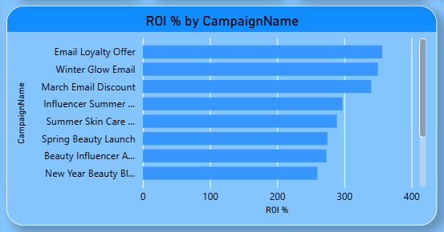
Business Questions / Challenges
Which campaigns delivered the highest ROI?
This graph shows the return on investment for each campaign.
Higher ROI means better profit for the money spent.
It helps find the most cost-efficient campaigns.

Slide 7
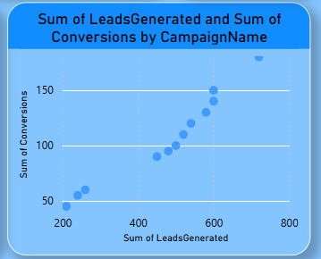
Business Questions / Challenges
Which channels (social media, influencer, email, events) are most effective in terms of conversions and cost per acquisition?
This shows the relationship between leads and conversions.
More leads generally result in more conversions.
Helps evaluate lead quality and campaign effectiveness.

Slide 8
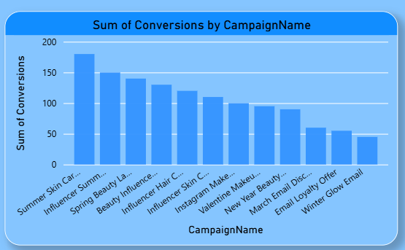
Business Questions / Challenges
Are there campaigns that generated high leads but low conversions? Why?
This graph shows how many conversions each campaign generated.
Some campaigns perform much better than others.
It helps identify which campaigns are most effective.

Slide 9
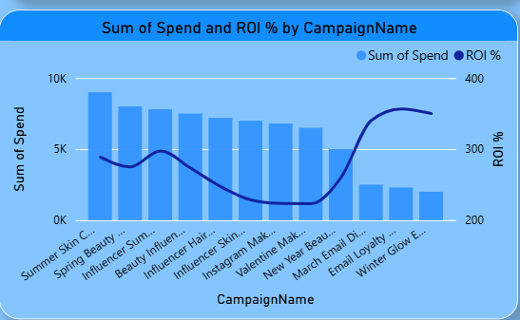
Business Questions / Challenges
Recommend strategies to improve ROI across campaigns (e.g., channel focus, timing, audience targeting).
This graph shows the return on investment for each campaign.
Higher ROI means better profit for the money spent.
It helps find the most cost-efficient campaigns.

Slide 10
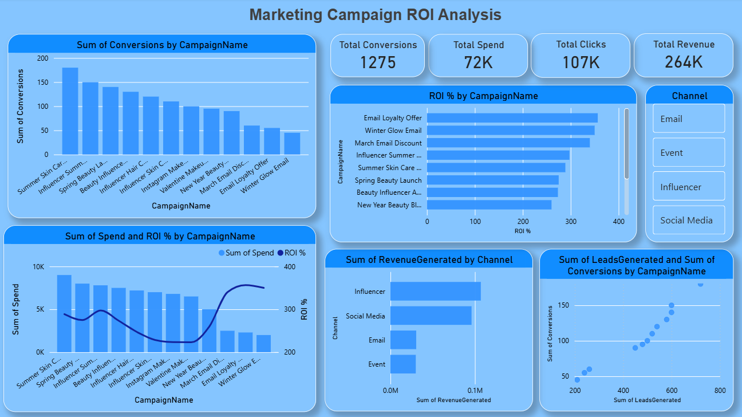
Dashboard

Slide 11
Conclusion
The analysis of Glow Up marketing campaigns highlights the effectiveness of different marketing channels in generating revenue and conversions. Influencer and social media campaigns showed strong performance in terms of ROI and customer engagement, while some campaigns generated high leads but lower conversions, indicating opportunities for improvement in targeting and campaign strategy

Slide 12
Recommendations
Allocate more budget to high-ROI channels like social media and influencer campaigns to maximize returns.
Improve targeting and content strategy for campaigns with high leads but low conversions.
Optimize underperforming campaigns by reducing spend or redesigning strategy.
Continuously track campaign performance and adjust budget allocation using data-driven insights.

Slide 13
THANK YOU!

